Slide 1

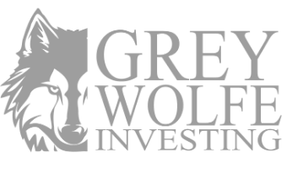
Asset Backed Income Notes
A Short Term Income Vehicle Backed By 200+ Contracted Buyers
RAISE AMOUNT
RETURN TARGET
TIMELINE
~$1.5M
20%
6–9 MO
Minimum Investment: $50,000

Slide 2


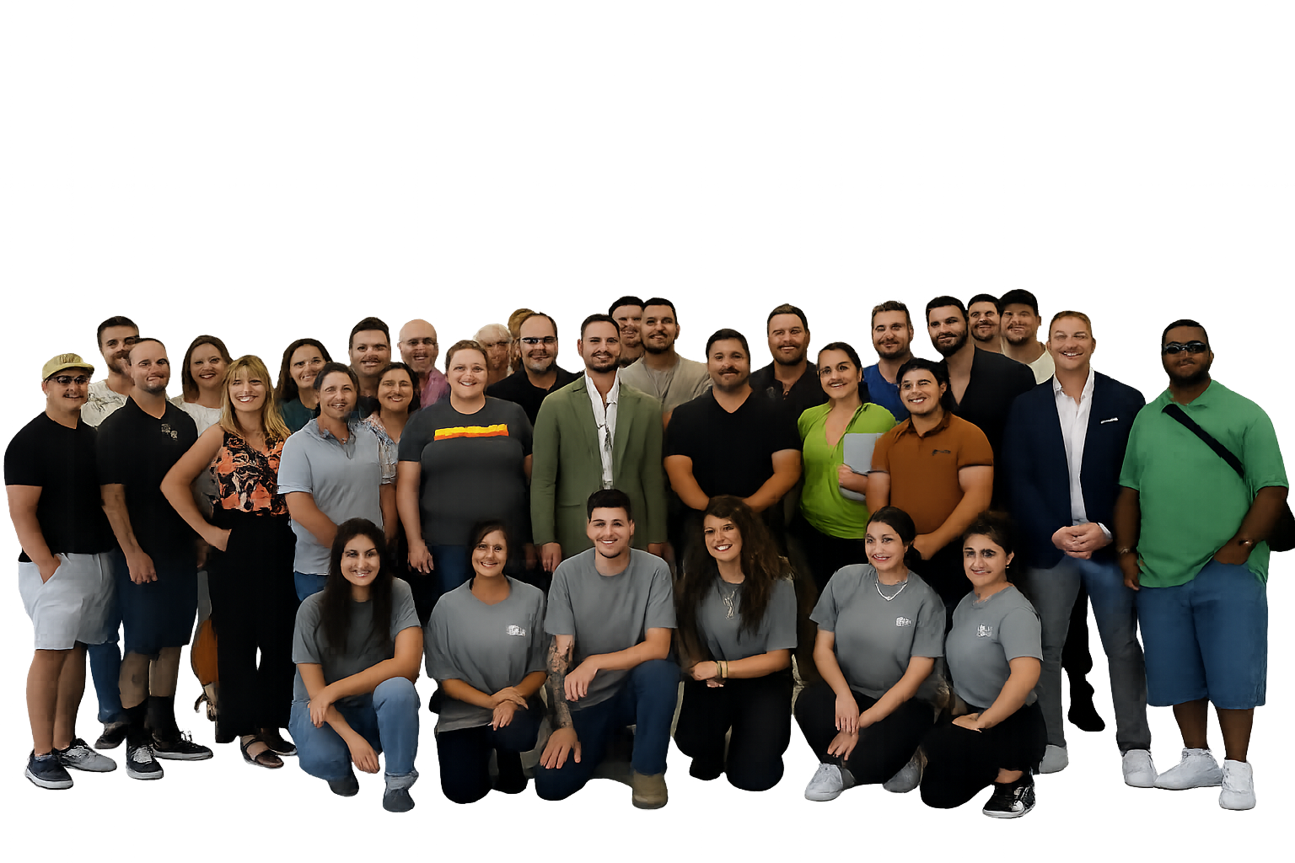
What We Do:
We source, handle, and distribute inventory into a contracted 300+ store network.
Greywolfe operates a SPN verified wholesale distribution platform. We secure brand inventory at negotiated pricing for standing purchase commitments from our partners.
EXPERIENCE
TRACK RECORD
PHYSICAL INFRASTRUCTURE
8 Years
$1.4B+
FL & COLOMBIA
In wholesale distribution
Products sold
Warehouse & Offices
GLOBAL REACH
CLIENTS
EMPLOYEES
38 Countries
300+
40+
Distribution network
Active investors
Full Time Employees

Slide 3


Our Model
3
• Greywolfe is reimbursed on inventory
Inventory Lands & Is Purchased
Inventory lands in our warehouse, our partnered stores purchase the inventory, inventory is processed by our team into our partners storefronts,
1
2
Negotiate & Secure Brand Deals
↓
Order Inventory
Leverage 7-year distributor relationships & Amazon SPN partnership to negotiate exclusive brand deals & terms.
We use our funds to order the pallets of inventory from suppliers, with a 2-3 month expected shipping window.
4
• Store Owner holds risk on end customer sales
Inventory Sells & Stores Reinvest
Inventory sells to end customers from our partners stores, creating profit for our partners (and a % profit share for Greywolfe), and stores reinvest to restock inventory.

Slide 4
Our Model
To Summarize:
We’re reimbursed (or profit slightly) once inventory lands.
We see a % of profits from sales to end customers with no fiscal risk.
We see additional profit from the brands directly through rebates, revenue shares, or equity earned.

Slide 5




The Opportunity
Brands Have Poor Distribution On Seller Markets
Greywolfe Solves These Because:
Most brands are focussed on being a supplier relying on wholesalers and distributors for the bulk of their revenue. Most lack in-house D2C channels.
We operate their marketplace channels and buy inventory directly, giving them wholesale revenue upfront while we handle the selling.
Brands lose control when too many sellers undercut pricing, which kills margins and makes revenue unpredictable. They need one centralized distribution partner to control price and volume.
We purchase inventory directly and consolidate sellers into one authorized channel, restoring pricing control and protecting margins.
Brands have to pay for inventory months before it sells, tying up cash with no guaranteed sell-through. This slows growth and creates unnecessary financial risk.
We buy product upfront through large purchase orders, turning slow inventory into immediate cash for the brand.
Marketplaces force brands into small, retail-style orders and operational complexity they were never built for. They want bulk buyers and large purchase orders, not thousands of individual shipments.
We handle listings, ads, fulfillment, and logistics, so brands ship pallets to one partner instead of managing thousands of individual orders.
Brands are stuck on the outside of a ~$600 billion distribution channel on Amazon alone, wanting the distribution, but fail to control or capitalize on.
We unlock access to Amazon’s massive third-party distribution while offerings brands guaranteed & scaleable wholesale revenue.

Slide 6
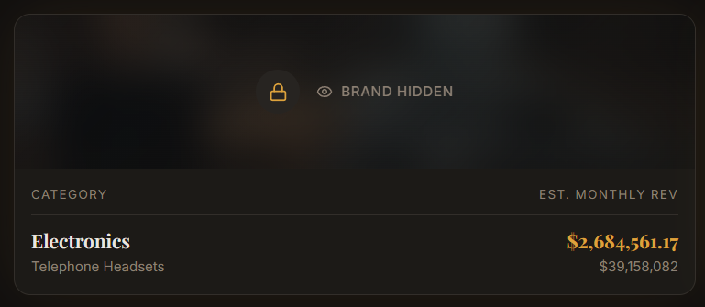
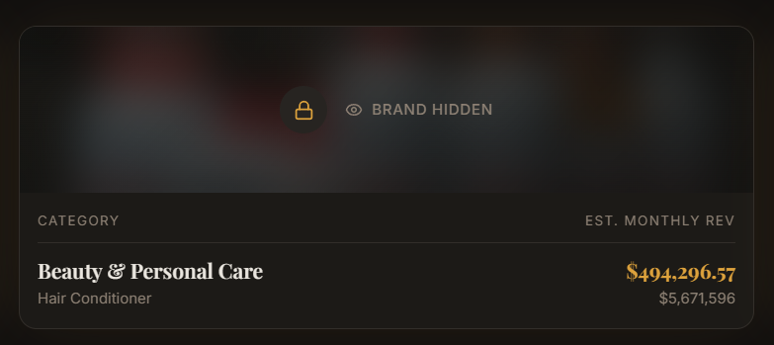
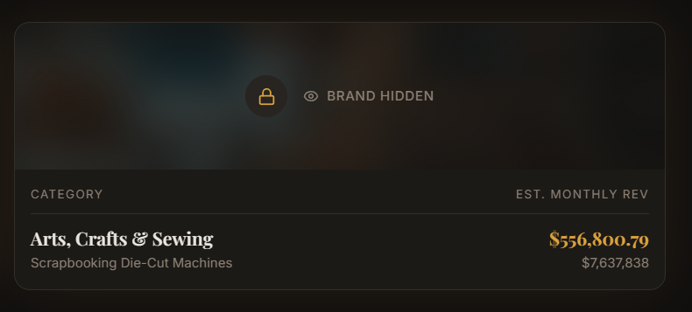
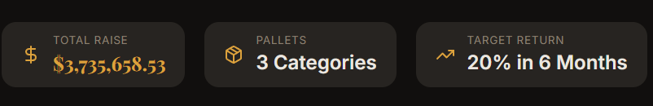
Today’s Opportunity
3 Exclusive Brand Deals • ~$1.5M Total Raise
BRAND 1 • HEALTH & BEAUTY
BRAND 2 • TOYS
BRAND 3 • FRAGRANCE
EXCLUSIVITY DEAL
EXCLUSIVITY DEAL
EXCLUSIVITY DEAL
$6.6M
~$6.7M
$7M+
Current sales volume
Current sales volume
Current sales volume
4x growth projected on Amazon
Exclusive distribution rights
Exclusive distribution rights
TOTAL RAISE
BRANDS
RETURN TARGET
~$1.5M
3 Exclusives
20% in 6–9 Months
*Brand & Product Specifics Available Upon Signature of NDA & Non-Solicitation.

Slide 7


Investment Structure
MINIMUM INVESTMENT
TIMELINE
$50,000
6–9 Months
Capital deployment to return distribution
MAXIMUM INVESTMENT
RETURN TARGET
$2,000,000
20%
*Fully Insured & Personally Guaranteed

Slide 8
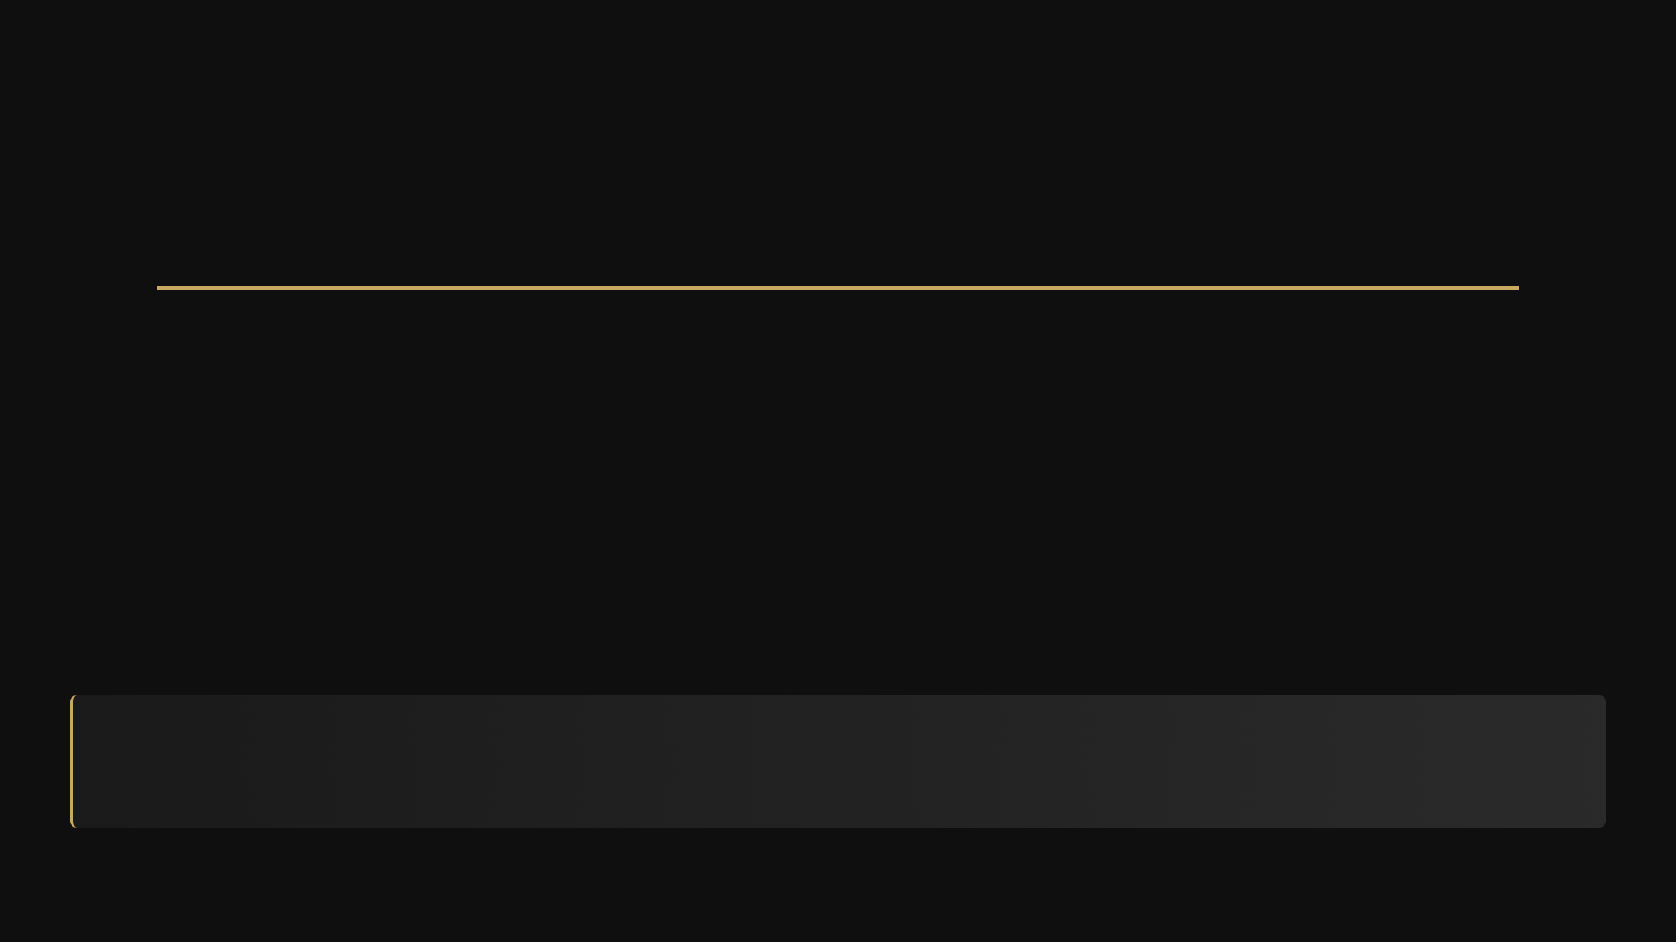





Timeline
1
2
3
4
Raise Minimum $500,000
Deploy Capital
Inventory Lands
Payback
Capital commitment from investors
Purchase inventory from brand partners
Inventory arrives & is processed.
Rebates are collected, and principal is paid back.
Month 0
Month 1
Months 2-3
Months 6–9*
* Up to 9 months in case of shipping delays
CAPITAL DEPLOYED
EXPECTED RETURN
ROI TARGET
TIMELINE
~$1.5M
~$300K
20%
6–9 MO

Slide 9
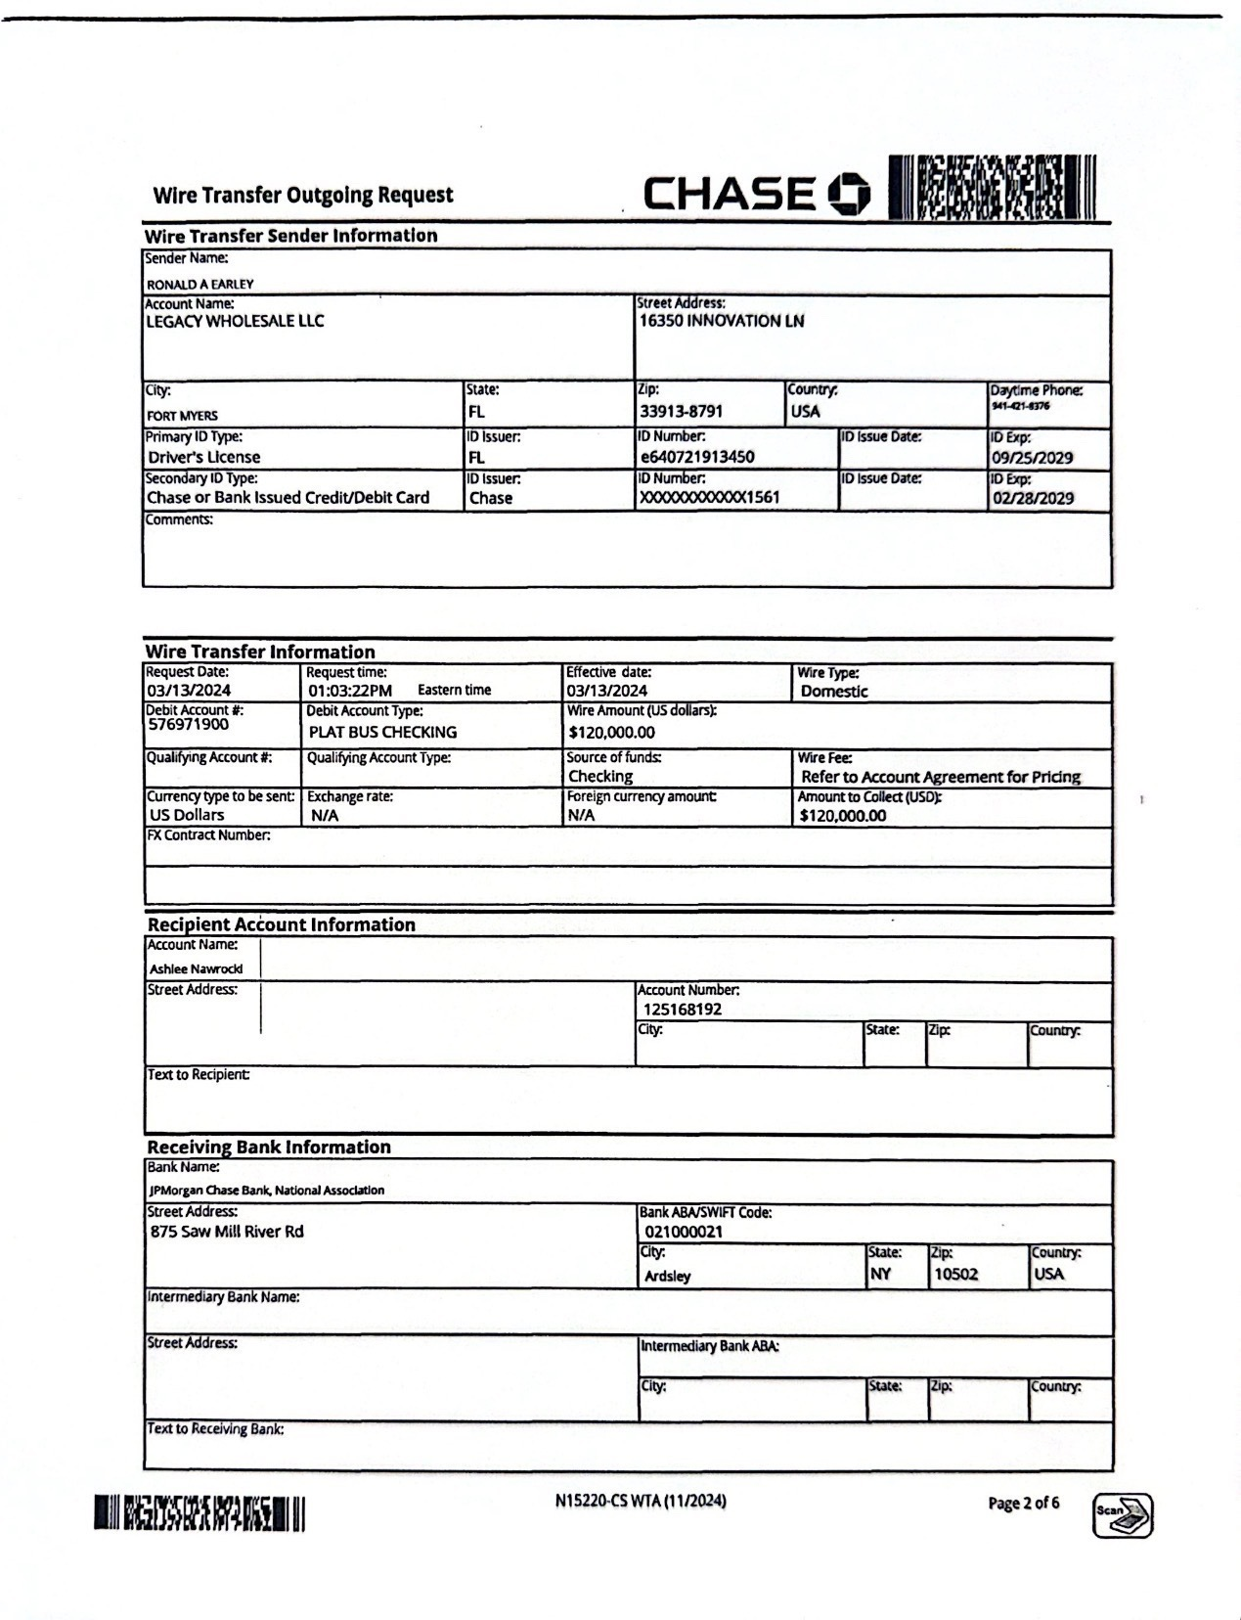


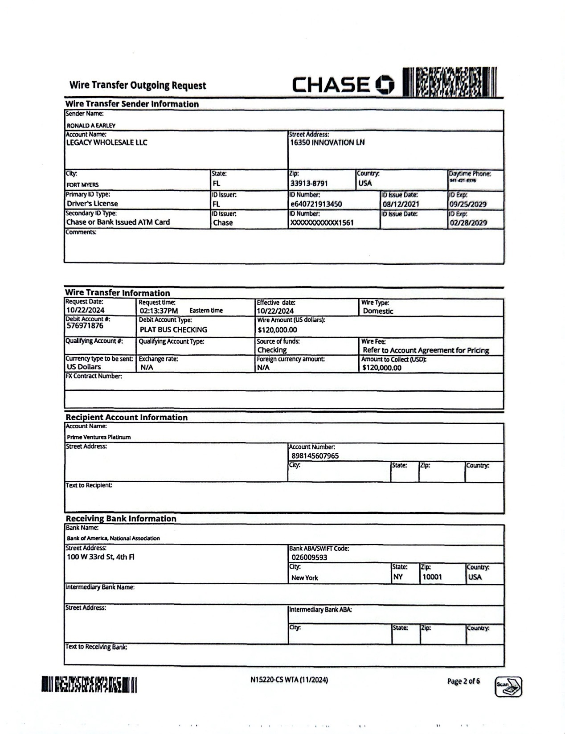

Track Record - Q2, 2025
BRAND PARTNERSHIP
Supplement Brand
• $200k in pre-paid inventory; $200k “Gap” Raised @ 20% in 6 months.
REBATE RETURN
$40,000
20% of $200,000
TOTAL RETURNED
$240,000
Principal + Rebates
*Brand & Product Specifics Available Upon Signature of NDA & Non-Solicitation.

Slide 10
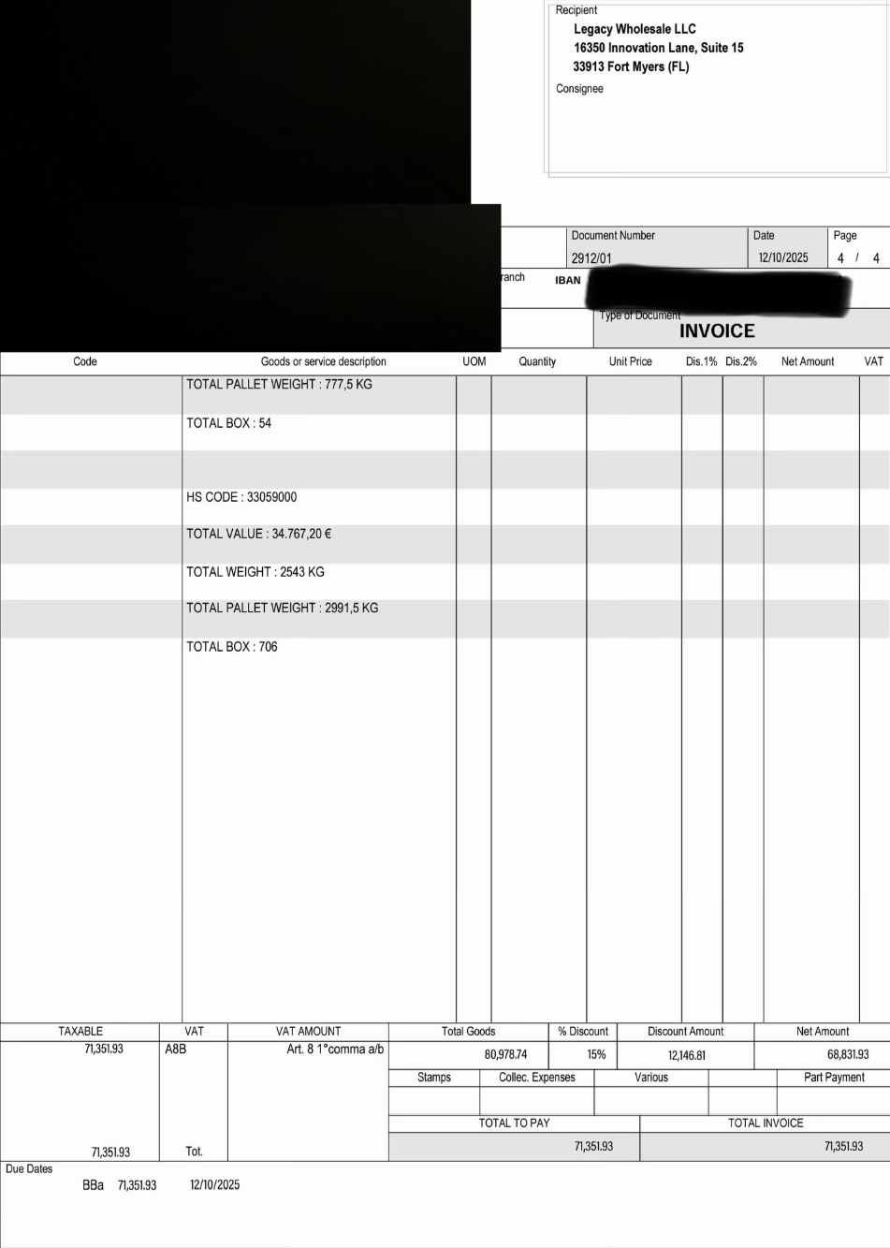

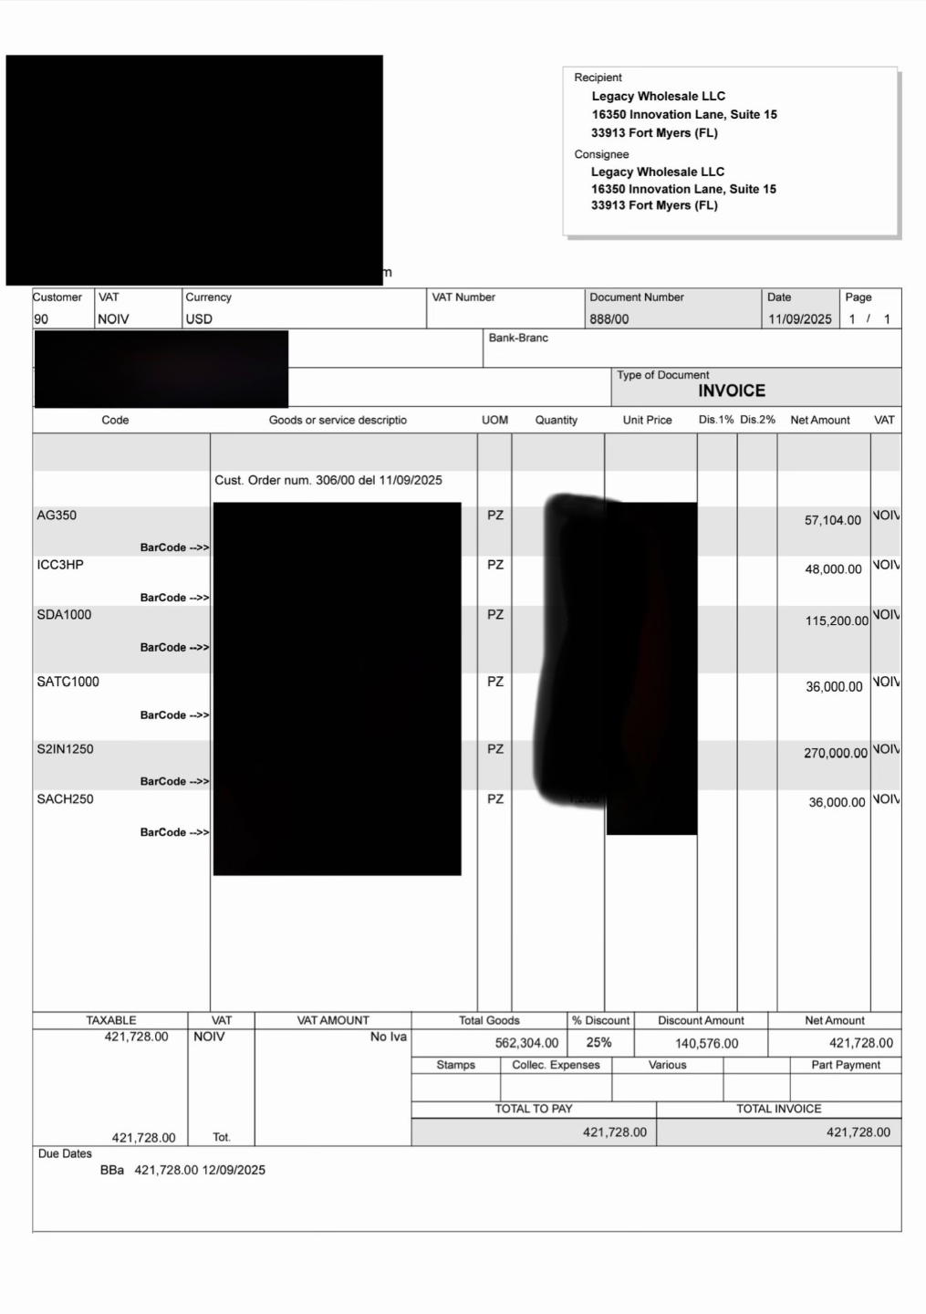

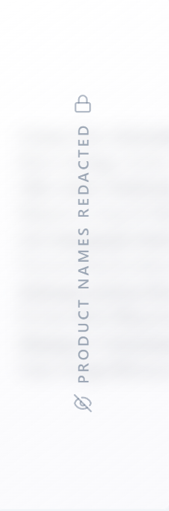
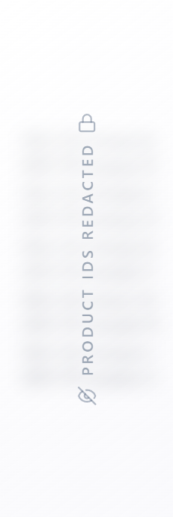
Track Record Q4, 2025 - In Progress
BRAND PARTNERSHIP
2 Brands: Supplement & Home Office Goods
• $950k Raised @ 20%, 6 Months
REBATE RETURN
$190,000
20% of $950k order
TOTAL PROJECTED RETURN
$1,140,000
Principal & Rebate
*Brand & Product Specifics, All Purchase Orders, and Real Time Delivery Status
Available Upon Signature of NDA & Non-Solicitation.

Slide 11
Track Record - $500K Raise, Completed
BRAND PARTNERSHIP
INVESTOR 1
3 Investors, Fully Funded
Paid Back
Principal + 20% returned
• $500k raised @ 20%, funded in addition to the wires shown.
REBATE RETURN
$100,000
INVESTOR 2
Paid Back
Principal + 20% returned
20% of $500,000
TOTAL VALUE DELIVERED
INVESTOR 3
$600,000
Rolled Over
Profits reinvested into the next deal
Principal + Rebates
*Brand & Product Specifics Available Upon Signature of NDA & Non-Solicitation.

Slide 12

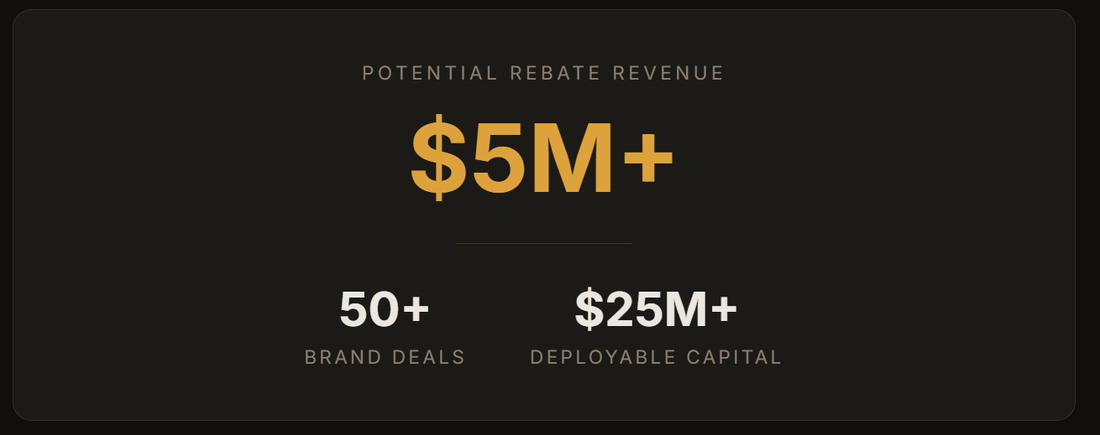
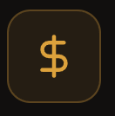

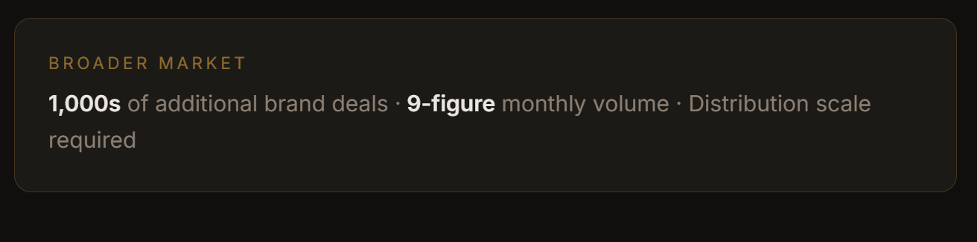
Future Opportunity
Active pipeline of verified brand deals ready for capital deployment - representing opportunities for repeated or compounded participation over the next 24-36 months.
50+ Brand Deals in Pipeline
Over 50+ verified brands, with substantial distribution, and similar rebate structures.
$25M+ Deployable Toward New Brand Deals
The pipeline represents over $25 million in deployable capital across these deals — constrained only by our current capacity, not by demand.
$5M+ In Potential Rebate Revenue
These deals carry over $5 million in potential rebate revenue — the profit center to investors on this deal structure.
* The broader market contains thousands of viable brand deals representing a multiple nine-figure monthly product volume. Scaling into this requires expanding distribution capacity — but the deals are on the table and the demand is there.

Slide 13

Risk, Mitigation, Common Q’s
Shipping Delays
Shipping Damage
Shipping typically takes 2 to 3 months, with occasional 1 to 2 month delays. We underwrite to a 6–9 month payback window to absorb normal delays, meaning returns may be pushed out but principal is not at risk.
Catastrophic loss or damage during shipping is possible, but all pallet orders are fully insured due to their size. In the event of loss, 100% of capital is recovered through insurance.
Lack Of Buyers
We have 312 contracted storefronts as exclusive buyers, with multi-six figures of inventory already prepaid. This diversified demand and distribution makes any large-scale buyer disruption highly unlikely. Only a true black swan event would prevent selling altogether.

Slide 14
Risk, Mitigation, Common Q’s
Key Distinction:
Profit or return on Principal are both completely unrelated to the performance and sales volume of the product itself.
Greywolfe’s end buyer is a Contracted Storefront. Not a consumer.

Slide 15
Why Do This?
Fast Turnover.
Fully Insured.
Buyers Contracted.
6–9 months, with potential for early payback.
No risk of loss outside of Black Swan event.
End buyers for return on principal already contracted.
Non-Correlative.
Track Record.
Return Potential.
Unaffected by economic or market swings.
Multiple deals like this successfully performed on.
20% per brand deal, with multiple deals a year.

Slide 16
What’s In It For Us?
Brand Advantage.
Partner Retention.
Brand Equity.
Lets us move higher-margin products with less competition, creating more profit from store sales.
The better brand deals and products we bring to partners, the longer they stay and more they spend.
We’re often able to secure revenue share or brand equity for increasing revenue from these channels.
Bolster Evaluation.
Potential Exit.
Company value increases per brand exclusive and with increases in distribution power.
The end vision is an evaluation and exit similar to Pattern, who IPO’d at a $2.6B evaluation.

Slide 17
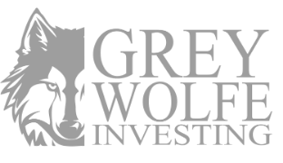


Ready to Invest?
Join us in building a portfolio of brands & brand deals.
NEXT STEPS
Schedule a call to discuss your participation.
Data & materials made available upon request
RAISE TARGET
YOUR RETURN
TIMELINE
~$1.5M
20%
6–9 MO
Greywolfe Investing | Enterprise Wholesale Distribution
"You Invest. We Manage."

